Slide 1
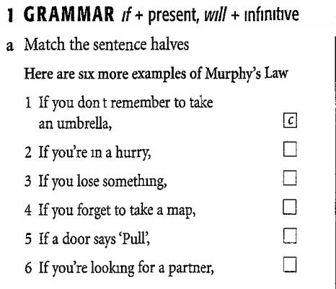
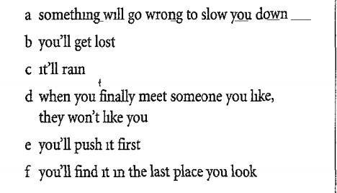

Slide 2
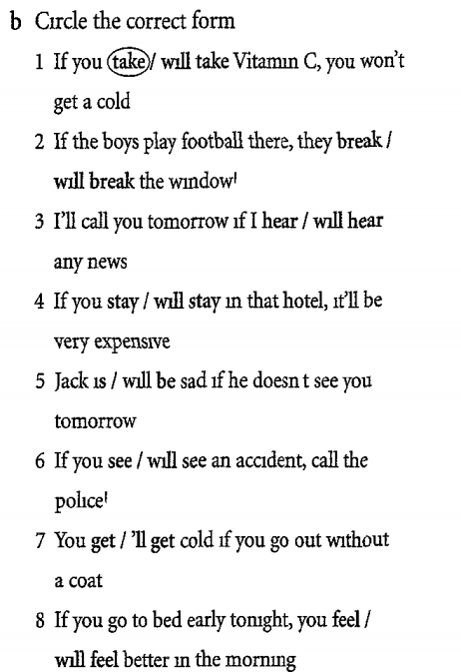
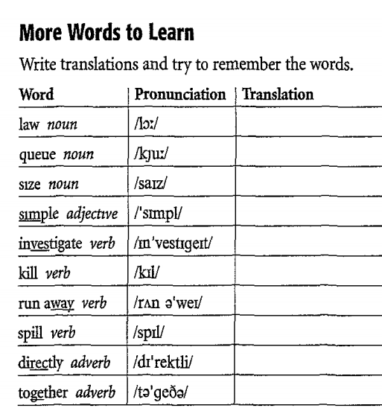

Slide 3
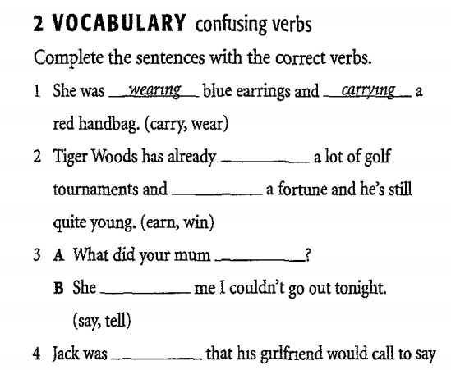
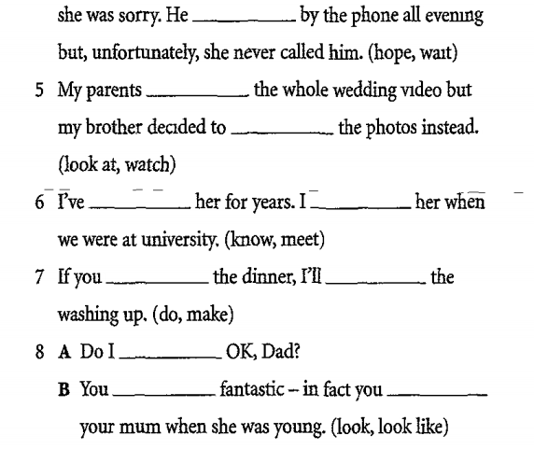

Slide 4
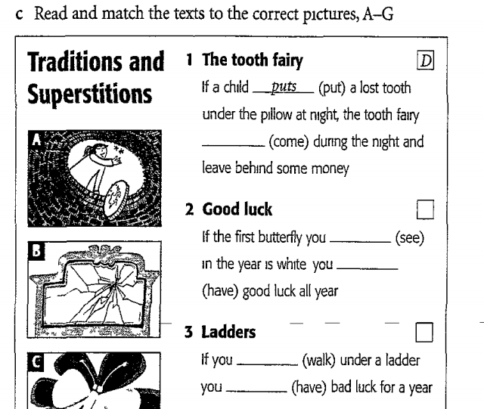
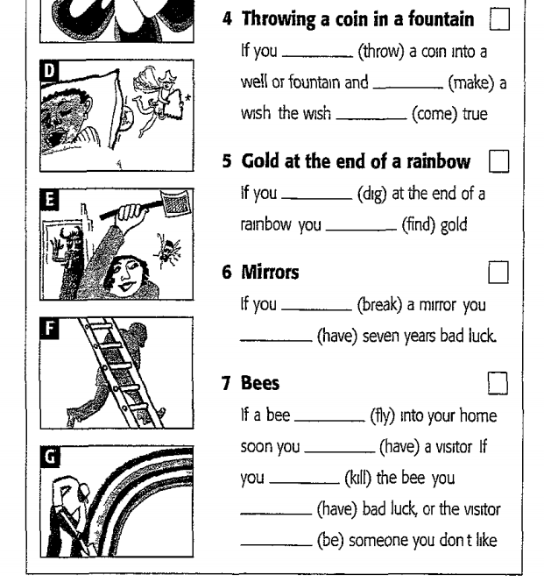

Slide 5
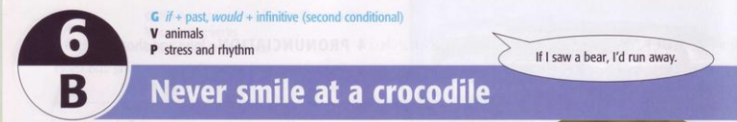

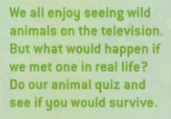


Slide 6
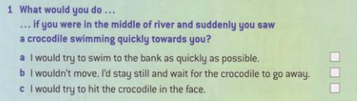
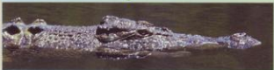
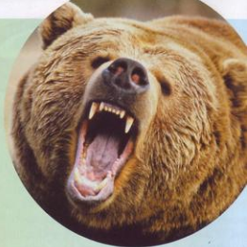
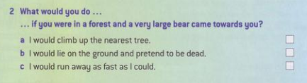
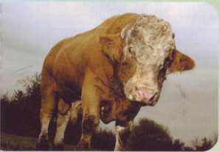
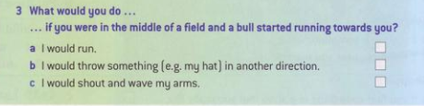

✓
✓
✓

Slide 7
1. a. I would try to swim to the bank as quikly as possible X
Because crocodiles attack very quickly so you don’t have time to swim
b. I wouldn’t move. I’d stay and wait for the crocodile to go away X
Because as soon as a crocodile sees you, it will attack
2. a. I would climb up the nearest tree X
Because bears can climb better than we can
c. I would run away as fast as I could X
Because bears can run faster than we can.
3. a. I would run X
Because bulls can run incredibly fast
c. I would shout and wave my arms X
Because noise or a sudden movement will attrack the bull and make it come towards you.

Slide 8
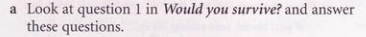
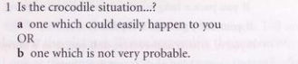
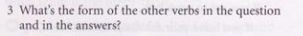
✓
Past simple
Would/wouldn’t + infinitive

Slide 9
THE SECOND CONDITIONAL (Unreal conditional sentences at present)
If I saw a lion, I would run away.
past simple would + infinitive
IF CLAUSE + PAST SIMPLE
saw / didn’t see
MAIN CLAUSE
would/wouldn’t + infinitive

Slide 10
USES:
We use the second conditional to talk about an improbable/impossible or hypothetical future situation and its consequence.
Ex: If a bear attacked me, I’d run away
= I’m imagining this situation. It’s very impossiple

Slide 11
NOTES:
Would/wouldn’t is the same for all persons.
- The contraction of would is ‘d (I’d, you’d, he’d, etc…) and of would not is wouldn’t.
The if phrase can come first or second.
Ex: If I saw a bear, I’d run.
OR I’d run If I saw a bear.
You have to use the “the comma” when the If clause comes first but the main clause comes first, you don’t need to use it.

Slide 12
Important Note!
Remember with can, use could + infinitive, not would can.
Ex: If I had a car, we could drive there.
Formal grammar requires that when making these kinds of conditional sentences, we use WERE for the past tense of be for all subjects (including I, he, she).
Ex. - She would buy a mansion if she were wealthy
- If I were you, I would buy that house.
for advice

Slide 13
FIRST AND SECOND CONDITIONALS
Use the first conditional for possible future situations.
Ex: If I have time tomorrow, I’ll help you
(= maybe I will have time)
Use the second conditional for improbable/ impossible or hypothetical situations.
Ex: If I had time tomorrow, I’d help you
(= I won’t have time)

Slide 14
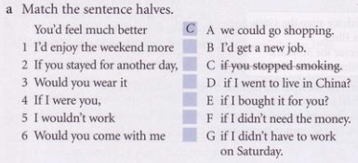
Exercises:
G
A
E
B
F
D

Slide 15
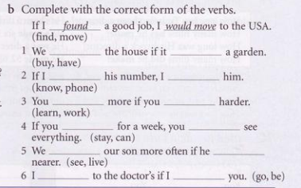
would buy
had
knew
would phone
would learn
worked
stayed
could
would see
lived
would go
were

Slide 16
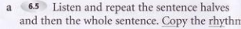
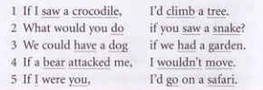
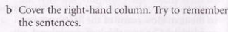

Slide 17
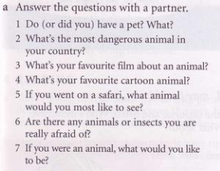

Slide 18
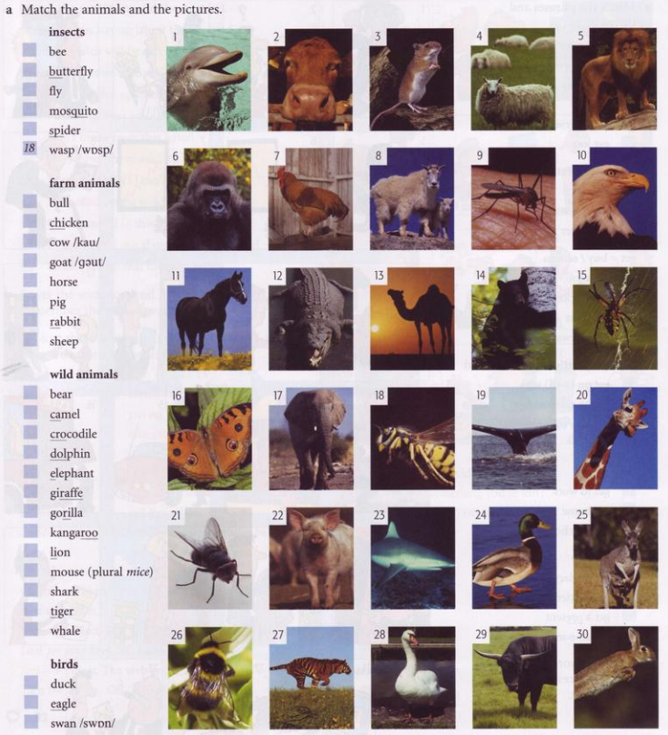
26
16
21
9
15
29
7
2
8
11
22
30
4
14
13
12
1
17
20
6
25
5
3
23
27
19
24
10
28

Slide 19
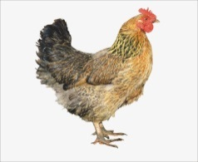
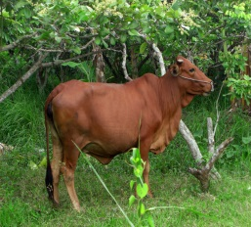
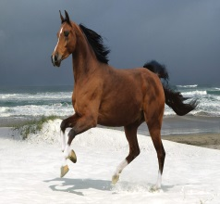
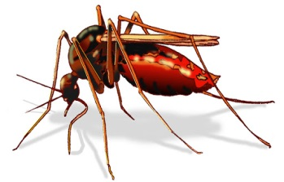
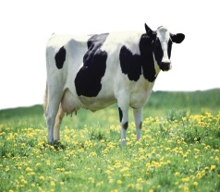
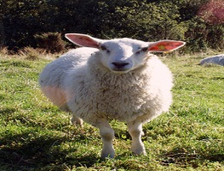
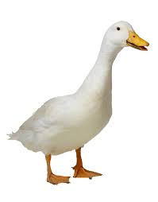
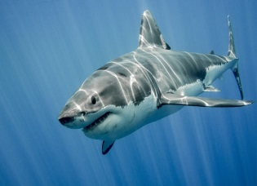
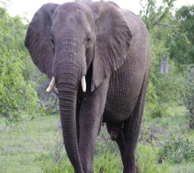
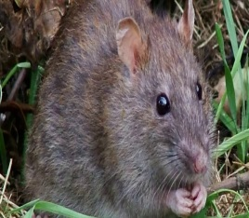
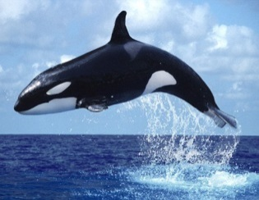
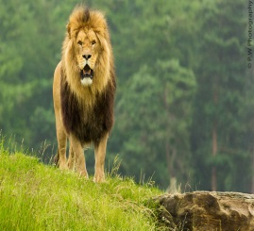
Chicken
Horse
Cow
Duck
Elephant
Lion
7. Bull
8. Mosquito
9. Sheep
10. Shark
11. Mouse
12. Whale

Slide 20
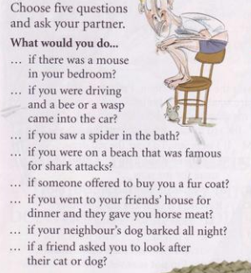

Slide 21
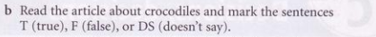
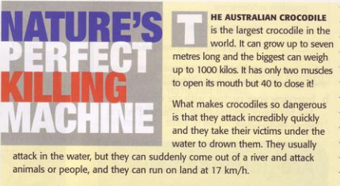
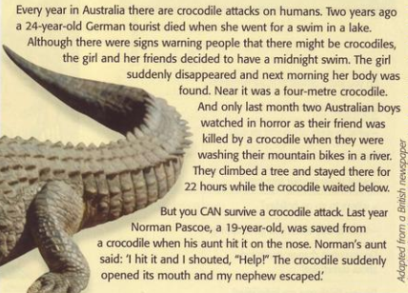
You try to hit the crocodile in the face

Slide 22
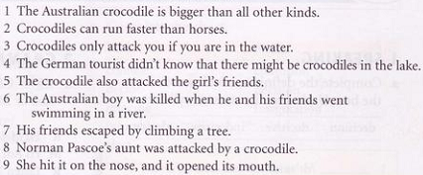
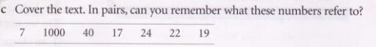
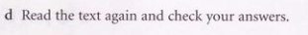
T
DS
F
F
DS
F
T
F
T
7: It refers to the length of a grown Australian crocodile
1000: it refers to the weight of the biggest crocodiles
40: It refers to the number of the muscles foe a crocodile to open it mouth.
17: It refers to the speed of a crocodile on land.
24: It refers to the age of the German tourist
22: It refers to the time that The Australian boy’s friends stayed on the tree
19: It refers to the age of Norman Pascoe

Slide 23
Fill in the gaps using the Second conditional
Exercises
If I…………(study) harder, I………………..get) to Oxford University.
If she………..(have) a bike, she………………(go) on a trip with us.
We………….(make) a pizza if we…………(buy) all the ingredients.
If my dad……………(can) speak English, he………………..(go) to England.
If I………….(check) the time, I…………………(not be) late for work.
If Paul………………(take) driving lessons, he………………(go) to work by car.
We………….(stay) longer if we…………..(have) time.

Slide 24
